Slide 1
False River Regional – HZR “Real World” LED Lighting Tests PROGRAM OVERVIEW SOLAR Retro-Reflector Markers RWY & Solar TWY – PWM & 6.6 / 6.6
LA DOTD AVIATION TRAINING WORKSHOP
SEPTEMBER 18, 2014
Notes:
The title of this presentation is Real World LED Lighting Tests – A Program Overview. Part of the presentation concerns solar powered LED Retro-Reflector Pavement Markers installed on the centerlines and taxiway pavement edge. The other part is an update of the low profile L-861 runway edge, solar powered taxiway edge and elevated L-861E LED fixtures powered by 2 amp DC series circuits using Pulse Width Technology (PWM).
Our presentation is to relay our findings to date, an “overview”, to all interested users and the industry manufacturers, the issues or impact of LED using 6.6 and PWM technology on both hard-wired series circuits and our report of solar powered self contained disposable pavement markers.
Some of you might have read or heard about the False River Regional Airport in New Roads, Louisiana. We will try to connect the dots of “WHAT” has been demonstrated to date, “What” has been accomplished, “What” issues have been encountered and “WHAT” actions and further testing is on the Horizon. Finally, Why Louisiana has made the investment to ensure a robust architecture, of airfield lighting systems is so important. Finally, we want everyone to “Do it correctly, wisely and understand the issues” when addressing the implementation of LED Technology.

Slide 2
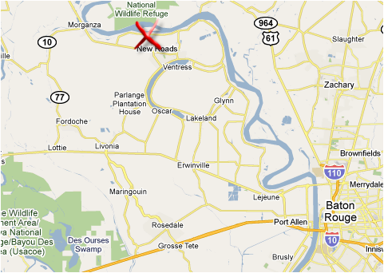
False River Regional Airport - HZR
Pointe Coupee Parish
New Roads, LA
Rwy 5003’ x 75’
Elev: 40 Ft.
AWOS-3P/T 121.250
or Tel (225)638-3107
CTAF - - - - 122.800
GCO - - - - - 135.075
LOC - - - - - 111.900
NDB – MHW 356
UNICOM - - 122.800
PAPI-2, 3.0°, 50’TCH
RWY 36 - - - ODALS
RWY 18 - - - REILS
LOC RWY 36 – RNAV (GPS) RWY 18 / 36 – VOR/DME-A – NDB RWY 36
Notes:
The testing of equipment and design standards are usually at False River Regional Airport due to its location, quality of airport maintenance, and professional management involvement in monitoring the project(s) and communicating with our office.
Flying to the False River Regional (HZR) direct from the Baton Rouge Metropolitan Airport (BTR) is 20 nautical miles (NM) on a North West Heading .
Driving from Baton Rouge Metropolitan Airport (BTR) direct to False River Regional takes 42 minutes, driving 35 miles via US61N from Baton Rouge.
Driving from downtown BTR to False River takes 46 minutes or 39 miles via Interstate 110, US-61N or 47min, 36 miles via Interstate 10, LA415, US190 W & LA-1N .

Slide 3
LONG TERM TESTING GOALS
Upgrade Systems – LED / Best Technology
Minimize Energy Consumption
Maximize Reliability - MTBF
Simplify Systems Operation
Minimize Repair/Troubleshooting Time-MTTR
Maximize Visual Impact
Improve Airport Operational Safety
Establish Cost to Benefit Ratio - CBR
Notes:
NAVAID program funding is strictly allocated to obtain a robust infrastructure based on three main goals during the decision making process: Increase - Mean Time Between Failure (MTTR), Decrease - Mean Time To Repair (MTTR) and Obtaining the Best Possible - Cost Benefit Ratio (CBR).
To embark on any new NAVAID program initiative - using new equipment, application or design requires actual field testing. Information is needed, to verify the manufacturer’s claims of reliability. The systems reliability, operational and maintenance requirement information allows us to make or modify our long term (five year) plan of capital improvements. Presently we use ten (10) years as the life span of electronic components (ILS, AWOS, RADIOS) for replacement. Airfield lighting system we use 20 years for replacement. The False River “Real World” LED Lighting Test Program is critical in making long term (20 year) decisions to implement for our airports.

Slide 4
The Beginning – Low Profile RUNWAY EDGE
Notes:
This is a photo of a Crouse-Hinds runway edge lighting fixture located at the WWII Hammond Northshore Regional Airport – The fixture is located on the East Side of Runway 18/36 approximately mid-field. This fixture gave me the inspiration to request the development of a low profile Medium Intensity LED fixture for GA airports.

Slide 5
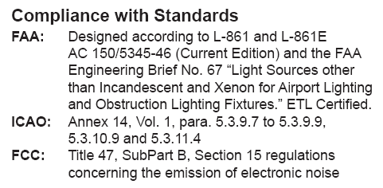
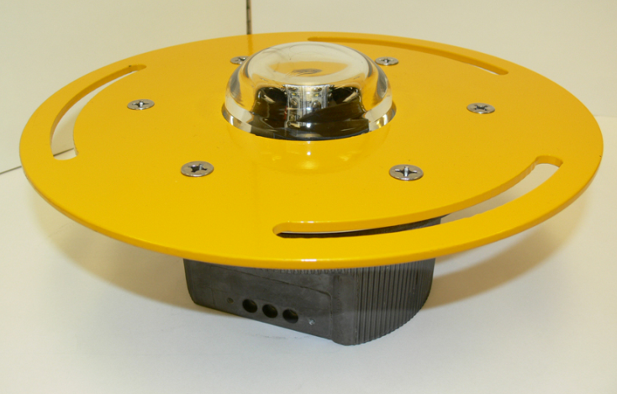
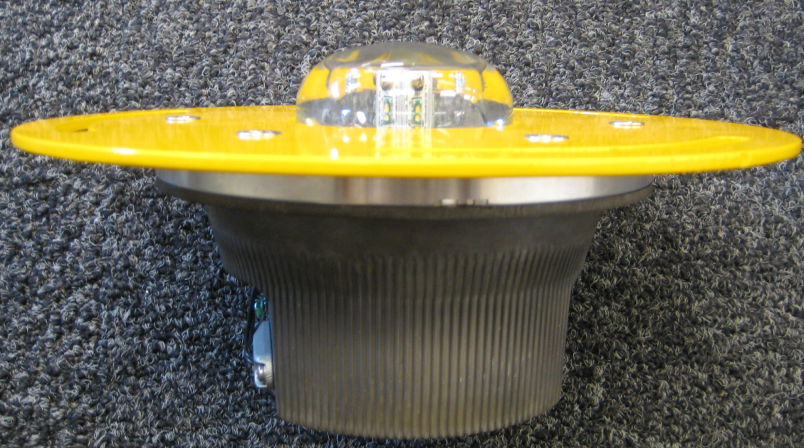
Low Profile Runway – (TAXIWAY) LED Fixtures
Notes:
This Fixture Design is presently used in the HZR Runway and Taxiway Edge Lighting PWM Test Program which is one of the test subjects in the presentation. The Taxiway version of this fixture was installed in early August 2012 thereby extending the LED Test Program until mid 2015 for this item. The taxiway fixture draws an approximate load of 6 watts with a 20/25 watt isolation transformer. The Runway fixture draws an approximate load of 15.2 watts with the 20/25 watt isolation transformer.

Slide 6
LED PWM RUNWAY EDGE & THRESHOLD Fixtures AT HZR
L-861
L-861E
Notes:
The early “Low Profile” runway fixture mounting bolt slots were too wide and therefore used stainless steel flat washers to temporarily address the issue. The newer “Low Profile” taxiway fixtures installed have corrected the issue with a new mounting plate with narrower slots eliminating the need for flat washers. Note: We are testing the use of ceramic coated bolts at False River Regional as well.
++++++++++++++++++++++++++++++++++++++++++++++++++++++++++++++++++++++++++++++++++++++++++++++++++++++++++++++++++++
Bolts (LSO-1 Light Base Flange Bolt – 3/8-16 x 1.5” @ 1.97 each) + freight were purchased from MCB Industries – Mary Baeten – 920-983-9740

Slide 7
PWM LED & 6.6 Quartz Thld Fixtures - INITIAL
Notes:
HZR provided an opportunity to perform a “real-world “ LED vs Quartz lighting system comparison – In the video segments the L-861E low profile threshold was changed to an elevated L-861E due to HZR pavement profile issues. The Legacy Quartz Lighting System Fixtures were installed in 1997 at 10 feet from pavement edge. The Threshold Fixture is an L-861 SE with 120 Watt Quartz Lamp with a 100 watt 6.6 Amp isolation transformer.
Legacy Medium Intensity Runway lighting system consists of 52 edge fixtures @ 45 watts and 16 threshold @ 120 watts for a total of 68 fixtures. The total runway circuit approximate load of 4,863 watts provided by a 6.6A – 7.5KW CCR.

Slide 8
LED & QUARTZ THLD FIXTURES – LATEST
Notes:
LED Medium Intensity Runway lighting system using PWM Technology consists of 52 edge and 16 threshold @ 15.2 watts each or 68 fixtures split into interleaved circuits with an approximate total load of 1,100 watts provided by two – 2.0 KW APS.

Slide 9
Runway Edge Fixture (typical)
Notes:
The L-861 LED low profile fixture with a 20/25 watt isolation transformer and the elevated L-861 Quartz Fixture with a 30/45 watt isolation transformer – There is an 8 foot separation between the fixtures.
Side by side comparison both circuits
(Removal of #2 PWM circuit energy) Test comparison of CCR vs half of the LED fixtures and see if the LED visibility is adequate for VFR or not lower than 1 mile visibility conditions for dusk to dawn operations by photocell only.

Slide 10
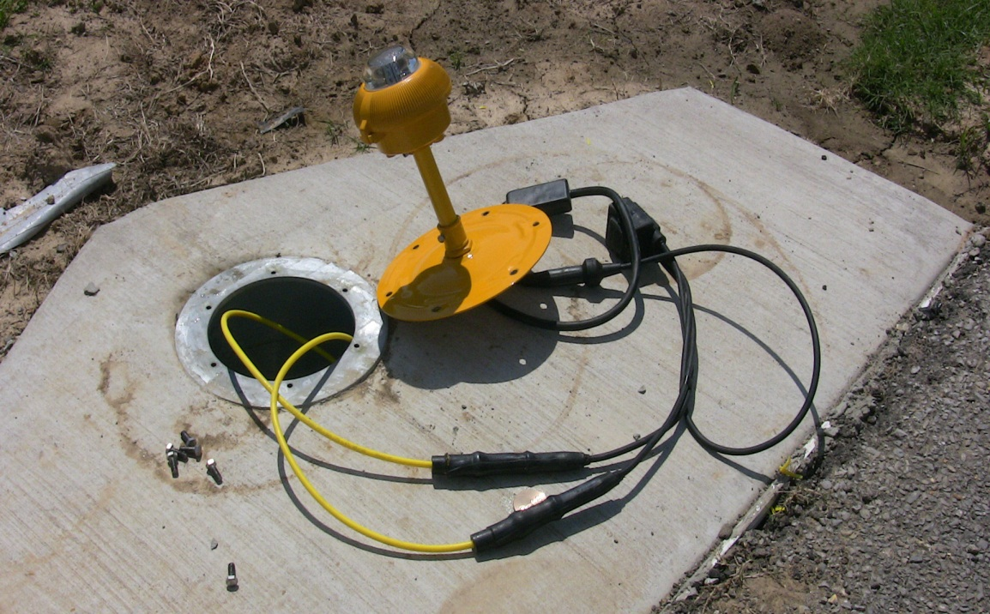
RUNWAY Edge Fixture – Elevated Color Coded 5KV CABLE Circuit – APS (PWM)
Shorting Device
Notes:
Example of using “Yellow” coded 5KV rated cable to warn airport maintenance personnel that they are working on an Advanced Power Supply (APS) circuit using Pulse Width Modulation (PWM) Technology. Shown also is an APS Shorting Device downstream of the isolation transformer secondary for use on elevated fixtures only.

Slide 11
SOLAR TAXIWAY LIGHTING ENABLED BY PWM Technology
ADVANCED POWER SUPPLY (APS) @ 10% INTENSITY
160 Taxiway L-852T Fixtures
APS Connected Load 863 Watts
Inverter - 1.00 Amp @ 240 VAC
Battery Voltage 51.29 VDC
Notes:
The APS is controlled at 0% Dusk to Dawn by Photocell and Pilot Controlled Lighting (PCL) for 30% & 100% for a 15 minute duration. The computer screen graphically showed the Taxiway Inverter Load – 1 Amp @ 240VAC – Batteries 51.2 VDC @ 9:40 PM on 2-12-2011.
+++++++++++++++++++++++++++++++++++++++++++++++++++++++++++++++++++++++++++++++++++++++++++++++++++++++++++++++++++
The Advantage of the APS - If you move the fixture electronics to the airport lighting vault and replace the 6.6A CCR with a 2.0A Advanced Power Supply (APS) to provide an alternating PWM. When the PWM current signal arrives at the fixture, the current is stepped down further by the internal fixture transformer to the desire amount for the LED. The fixture transformer output then goes to a bridge rectifier that reverts the negative side of the alternating PWM to the positive.
+++++++++++++++++++++++++++++++++++++++++++++++++++++++++++++++++++++++++++++++++++++++++++++++++++++++++++++++++++++
Presently, in 6.6A circuits to enable LED, electronics are used to convert the step-down AC into the proper type of DC current (PWM) that the LED Requires within the fixture. This method is successful and allows us to use existing infrastructure, i.e. field cables and CCRs, however we lose efficiency of the LED. In 6.6A circuits to drive a 1 VA LED we need 15VA or 21VA, definitely better than the 45 watt quartz lamp, but…….

Slide 12
PULSE WIDTH MODULATION (PWM) WAVE FORM
From The Advanced Power Supply (APS)
APS – 10% Intensity 231 VDC @ 2 Amps
Notes:
Load on the Taxiway System April 6, 2010 with L-852T Fixtures without isolation transformers. 10% Intensity, 231 volts DC.

Slide 13
PULSE WIDTH MODULATION (PWM) WAVE FORM
From The Advanced Power Supply (APS)
APS – 100% Intensity 371 VDC @ 2 Amps
Notes:
Load on the Taxiway System April 6, 2010 with L-852T Fixtures without isolation transformers. 100% Intensity, 371 volts DC.

Slide 14
1.75 KW OFF-GRID PHOTOVOLTAIC ARRAY
48VDC PASSIVE COOLING BATTERY ENCLOSURE
Notes:
Sharp “NT-175UC1” Solar Module – Max Power 175 watts - 10 Modules – Each Solar Bank Circuit consists of 2 Modules in series – Mono-Crystalline Silicon Cell - Maximum System Voltage 600 V
Array Dimensions (10.5 ft x 13.3 ft or 140 sq.ft. Top-Pole Wind Loading is 90 MPH with an Array Angle of 20 degrees facing South.
How did we sized the solar system. This is not just matter of putting a solar panel, batteries, charger and inverter. Some calculations needed to be done.
The autonomy of the system was determined by the amount of power consumed.

Slide 15
WATER JACKETED “Cool Cell” Enclosure
GEL CELLS - 795 Amp Hour @ 48 VDC
Notes:
12 each Sealed Lead Acid Gel Battery – MK Battery Model 8G8D – rated 265 Amp Hour and capable of 1150 CCA @ 0 degrees F – The total system is rated 795 Amp Hour @ 48 Volts wired in series & parallel. – The system is was initially designed to provide 3.5 days of Autonomy at 50% depth of discharge, the batteries are expected to have a five (5) year lifetime, but only time will tell.
“Cool Cell” uses potable water for passive cooling – The water tank is a heat sink which absorbs heat from the sun and from battery charging. At night, when ambient temperature drops, warm water within the tank rises by convection to the plenum lid and radiates heat to the cold night sky. Cool water falls to the tank below. This thermo-siphoning continues throughout the night. In the morning as the lid warms, circulation stops, leaving chilled water in the tank to absorb another day of heat.

Slide 16
3 kW Inverter & Charge Controller
Charge Controller
Inverter
Notes:
Outback FX 3048 sealed inverter - output 120 VAC – 1 phase – Inverter output (240 VAC thru Transformer) directly wired to automatic transfer switch allows switching between solar or utility power. Airport Lighting Vault Utility power has 60 kW Diesel Generator with automatic transfer switch.
Inverter converts the 48 V DC into a 120 VAC and then it goes to an autotransformer that steps 120 VAC up to 240 VAC.
+++++++++++++++++++++++++++++++++++++++++++++++++++++++++++++++++++++++++++++++++++++++++++++++++++++++++++++++++++
The Charge controller digital display is loaded with information such as:
"Input" = Charger means from solar array. "Output" = Charger means to batteries. "Runtime" on all of them is the amount of time it was active.
"Bulk" is the charging stage when batteries are typically less than 90% full. It is "constant current / rising voltage", basically shoving as much power as possible into the batteries.
"Absorb" is the charging stage when batteries are between 90 and 100% full. It is "constant voltage / declining current" stage that finishes charging the batteries.
"Float" is the charging stage when batteries are 100% full and being trickled charged. It is a "constant (but lower) voltage / constant current" stage that maintains the batteries at 100% state of charge.
With data we get insight, but the best way is long term testing which is the LADOTD Aviation “Real World” LED Test Program is all about.

Slide 17
INITIAL l-852t led TAXIWAY fixture TEST - PWM
Removal of L-861T Quartz 6.6A
Install L-852T – 2.0A DC - PWM
Notes:
New L-852 LED Fixture (PWM) replacing 160 each L-861T elevated “Pop Top” 45 Watt Quartz Lamp and L-830-1 30/34 watt 6.6/6.6 isolation transformer - L-867B Taxiway Lighting can & conduit system installed in 1997. Meg reading allowed usage of existing 5 KV cable with new L-823 connectors and Heat Shrink Tubing – Partial Sealant on Tube Ends. In 2012 one L-823 connector failed. See “Failed L-823 Connector” Slide.
+++++++++++++++++++++++++++++++++++++++++++++++++++++++++++++++++++++++++++++++++++++++++++++++++++++++++++++++++++++
Previous taxiway quartz fixtures, 160 @ 45 watts with wiring approximate load of 9,157 watts provided by a 6.6A - 15KW CCR.
+++++++++++++++++++++++++++++++++++++++++++++++++++++++++++++++++++++++++++++++++++++++++++++++++++++++++++++++
Initial TWY L-852T LED fixtures, 160 @ 4.14 watts with wiring approximate load of 686 watts provide by a 1 KW Advanced Power Supply (APS) powered by a 48VDC inverter. Cable loss is 48 watts.
++++++++++++++++++++++++++++++++++++++++++++++++++++++++++++++++++++++++++++++++++++++++++++++++++++++++++++++++
The inverter output is 120 VAC with an auto-transformer for 240VAC. The initial present Input current is at 10% is approximately .49A - 126 VA, 30% is .96A – 247 VA, and 100% 2.78A – 717 VA.

Slide 18
LIGHTING VAULT EQUIPMENT UPGRADE TWY & RWY CIRCUIT 1 & 2 EDGE LIGHTING – APS SIGNS - PAPI – REIL - ODAL - Legacy Rwy–6.6A CCR
1 KW TWY APS, 4KW PAPI, 4KW REIL
APS & Solar Computer Console
2KW RWY ADVANCED POWER SUPPLY
(APS) – Pulse Width Modulation (PWM)
Notes:
The lighting vault upgrade consisted of replacing a 15KW Taxiway Regulator with a 1KW rated APS, replacing two 7.5 REIL & PAPI Regulators with 4KW Regulators, install a 4KW dedicated sign regulator, and replacing the existing 7.5 KW “Legacy” Regulator. These four new regulators were stacked to allow spacing for the new APS equipment for the LED Test Program. Each APS PWM Runway “IMEL” or “EMIL” Fixture have a 15.2 watt load with the 20/25 watt isolation transformer – Interleaved Circuits

Slide 19
EVOLUTION OF PWM LED TAXIWAY Edge Fixtures AT HZR
L-852T
L-861T “IMIL”
Notes:
The initial test were with the L-852T due to the fixture already meeting FAA certification, it took just over a year for Fire Ants to perform their destructive magic on the fixture primary cable L-823 pigtails. The L-852T fixture load is approximately 4.2 watts.
The new L-861T “IMIL” installed in July 2012 incorporated the narrower flange bolt slots, Teflon insulated wired fixture pigtail, and the re-installation of 20/25 watt L-830-17 isolation transformers. The L-861T fixture load is approximately 6.0 watts.

Slide 20
HZR ENERGY REDUCTION COMPONENTS
Solar Powered Taxiway Lighting – L-852T – Pulse Width Modulation
Relocation of L-852T TWY to 2’
Install APS Interleaved RWY Lighting System
Upgrade Vault CCRs & HVAC to Step Capacity
Upgrade RWY 18 REILS (Strobe) to LED – 6.6A
Upgrade L-807 Wind Cone - L-858 Signs from Quartz to LED – 6.6A
Upgrade Three Channel PAPI-2 System to Single Channel – 6.6A
Solar Reflector Markers – Centerline & Edge
Convert TWY L-852T to L-861T add Isolation Transformers
Notes:
In 2009 we embarked to test the HZR lighting system to take advantage of new technology such as PWM. Also - during this test period - we wanted the opportunity to lower the airport’s operational costs by lowering the electrical usage by just updating other equipment as well such as the HVAC. Energy Reduction testing included various installation configurations and installation methods during long term testing phase helps us to gather construction cost information.
The delicate balance to obtain the best reasonable CBR and MTBF depends directly on the method of installation which can definitely affect the MTTR for equipment or system. (example conduit or direct burial)
However, the manufacturer must be realistic with “The Customer” and communicate the trade-off between the advantages and dis-advantages of his equipment relative to maintenance costs, installation and reliability.

Slide 21
Energy Reduction - KWH USAGE FEBRUary 2009 thru AUGUST 2014
PWM CONTRIBUTED 80% OF ENERGY SAVINGS – BEFORE SOLAR !
Notes:
Average prior to the Solar & PWM LED Test Program the airport averaged consumption of approximately 6600 KWH (Kilo Watt Hours). The Taxiway load was completely removed from the monthly load resulting in a connected load of more than 7200 watts during operational hours or approximately 1400 KWH in the utility billings. The Runway LED lighting using PWM modification lowered the connected load approximately 3200 watts and the PAPI single channel conversion lowered the connected load approximately 1500 watts. Since 2009 HZR effectively has lowered their airport lighting system “Real World” energy consumption 50%.
However, but at what indirect costs? The solar system battery replacement alone is anticipated in 2015. Can we get one or two more years out of the batteries using the passive “Kool Cell”?

Slide 22
WHICH SYSTEM TO USE LONG TERM ?
ELECTRICAL INFRASTRUCTURE RESEARCH TEAM – (EIRT)
STANDARDS BASED - ROBUST ARCHITECTURE
APS (ALTERNATING PWM SERIES CIRCUIT)
REDUCED CURRENT AC SERIES CIRCUIT
LOW MODULATED AC CURRENT SERIES CIRCUIT
2 AMP POWER LINE CARRIER SERIES CIRCUIT
PARALLEL
“REAL WORLD – LONG TERM TESTING IS RECOMMENDED”
Notes:
We highlighted the importance of a “Robust” architecture requirement for “New Technology”, the FAA has established “EIRT” (Electrical Infrastructure Research Team), a team of experts evaluating alternate power supply architectures for LED-based airfield lighting circuits. It is important to consider, in the selection process, the characteristics, low power consumption, necessary so that solar could be a power option.
++++++++++++++++++++++++++++++++++++++++++++++++++++++++++++++++++++++++++++++++++++++++++++++++++++++++++++++++++++++
The EIRT Team is scheduled to visit the False River Regional Airport December 11th and 12 in 2012 to see 1st hand False River LED Test Program.

Slide 23
“ITEMS UNDER TEST or READY TO TEST”
Photocell control “Dusk to Dawn” of Circuit “A” of Interleaved LED RWY Lighting
PCL control “15 minutes” – 3 “Mike Key Clicks” of Circuit “B” of Interleaved LED RWY Lighting
LED PAPI Systems – Starting 4th Qtr 2014
Notes:
Cut the energy consumption - in half - of a runway lighting system operating dusk to dawn and lower the “Circuit B” exposure to thunderstorm lightning damage when de-energized.

Slide 24
Think – What If – WE Can ? “Improve FIXTURE Replacement Economics”
FOR 6.6A ELEVATED LED
“MOVE – ELECTRONICS”
Move the elevated fixture electronics package inside the L-867 or L-868 can - to be connected between the 6.6A L-830-* isolation xmfr. and the fixture optics.
Shorting Device Example
(Add Light Engine Electronics)
Notes:
The need to lower the LED fixture cost was dramatically demonstrated recently and directly led to the decision not to install LED lighting at the New Orleans Lakefront Airport. The airport received considerable water levels 2 plus feet above the pavement surfaces. Due to the brackish salt water and level of Lake Pontchartrain rising up from the airport’s storm water drainage system during Hurricane Isaac we lost only seven (7) L-861 series fixtures and had trouble with five L-858 signs using quartz halogen lamps. At a nearby airport, Reserve – St. John The Baptist Parish Airport does have LED L-858 signs, L-861 taxiway fixtures and L-849 REILS. Only a small portion of that airport received flooding from Lake Pontchartrain with every LED fixture, sign and REIL with destroyed electronics. Moving the LED electronics to within the L-867B can on a 6.6 system would allow Lakefront to convert to LED. Over 1,035 L-861 & L-862 fixtures and 144 L-858 Signs.

Slide 25
L-853 – MARKERS, RETRO-REFLECTIVE FAA GUIDANCE - 1969 to 1983
AC 150/5340-20 – Installation Details and Maintenance Standards for Reflective Markers for Airport Runway and Taxiway Centerlines, February 17, 1969
Evaluation of Retro-Reflective Pavement Markers for Precision and Non-precision Runways – FAA Technical Center, Guy S. Brown & Larry W. Hackler, DOT/FAA/CT-82/112, DOT/FAA/RD-82/83 – Interim Report, December 1982
Identification of Exit Taxiways (Retro-Reflective Markers Only) – FAA Technical Center, Larry W. Hackler, DOT/FAA/CT-82/77 Interim Report – June 1982 and DOT/FAA/CT-83/5, DOT/FAA/RD-82/91 – Final Report, April 1983
Notes:
AT HZR we had the opportunity to test some solar powered LED retro-reflector markers that recently were made available. Some of the older Advisory Circulars such as 150/5340-20 issued in 1969 addressed reflective markers, but we did not think about LED enhanced reflective markers in 1969, or 1982 or 1983. However, the information from these early advisories and test evaluations helped me to make the jump to test the implication of the addition of the LED.

Slide 26
L-853 – MARKERS, RETRO-REFLECTIVE FAA GUIDANCE - PRESENT
AC 150/5345-39D – Specification for L-853 Runway & Taxiway Retro-Reflective Markers, September 26, 2011
AC 150/5340-30H – Design and Installation Details for Airport Visual Aids, July 21, 2014
Addendum to AC 150/5345-53D - Certified Equipment and Manufacturers List, August 15, 2014
Notes:
These are the present Advisory Circulars concerning Retro-Reflective Markers and their installation on an airfield. Please note that there is no one offering an FAA approved L-853 pavement marker as listed in the current Addendum. However, the opportunity to test the LED inclusion in a pavement centerline marker was not hard to resist - as it was “Solar Powered Dusk to Dawn” !
This is what we saw, please understand that what you see today in the next video segments will not be as impressive, if and when you personally see an LED pavement marker in the dark of night at an unfamiliar airport.

Slide 27
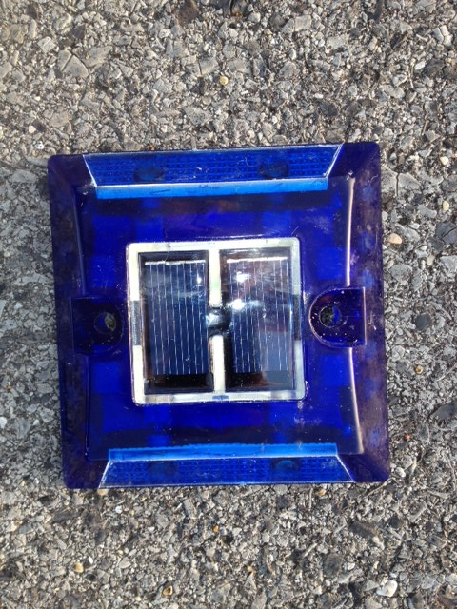
Solar Reflector Markers – ORIGINAL HZR INSTALLATION – JULY 2012 LOAD BEARING 40,000 PSI
Taxiway Edge Reflector
Taxiway Centerline Reflector
Removed September 2013
Notes:
The pavement marker configurations we tested were two LED uni-directional (for approaching turn information) and four LED bi-directional along the centerline or taxiway end directional turns. We also installed a 2000 foot segment of blue taxiway pavement edge four LED bi-directional reflector pavement markers for testing. Spacing was 25 feet in straight segments and 12.5 feet or less in turns.
+++++++++++++++++++++++++++++++++++++++++++++++++++++++++++++++++++++++++++++++++++++++++++++++++++++++++++++++++++++
Spacing was tested at 50 foot, however, due to anticipation of long term failure percentages (over four years) the 25 foot spacing may be our final recommendation.

Slide 28
Solar Reflector Markers – NEW HZR Installation – Sept 2013 LOAD BEARING 60,000 PSI
Taxiway Edge Reflector
Taxiway Centerline Reflector
Taxiway Edge – Not Installed at HZR
Taxiway Centerline – Installed at HZR
Notes:
The pavement marker configurations we tested were two LED uni-directional (for approaching turn information) and four LED bi-directional along the centerline or taxiway end directional turns. We also installed a 2000 foot segment of blue taxiway pavement edge four LED bi-directional reflector pavement markers for testing. Spacing was 25 feet in straight segments and 12.5 feet or less in turns.
+++++++++++++++++++++++++++++++++++++++++++++++++++++++++++++++++++++++++++++++++++++++++++++++++++++++++++++++++++++
Spacing was tested at 50 foot, however, due to anticipation of long term failure percentages (over four years) the 25 foot spacing may be our final recommendation.

Slide 29
Solar Reflector Markers
TWY to RWY Lead In - Exit
TWY to RWY Lead In - Exit
Only at TWY Side of HOLDLINE
RWY SIDE OF HOLDLINE
Alternating Yellow & Green
Notes:
Runway to taxiway lead in pavement markers, when installed and maintained properly, can be a significant nighttime visual aid airport enhancement for pilots. The FAA Technical Center Reports on L-853 Retro-Reflective Markers for “Identification of Exit Taxiways” (Retro-Reflective Markers Only) Interim Report of June 1982 and Final Report of April 1983 were the first that identified the need for this visual enhancement. The solar LED reflector marker test videos, hopefully give you an understanding why we are conducting further long term tests at part of our LED Test Program at HZR to establish realistic MTBF, MTTR and CBR numbers for this visual aid (Navaid) enhancement.

Slide 30
Solar Reflector Markers Alternating COLORS
RWY Lead in to TWY - Exit
RWY Lead in to TWY - Exit
ONLY ON RUNWAY PAVEMENT
Notes:
Runway exit to taxiway lead in pavement markers, when installed and maintained properly, can be a significant nighttime visual aid airport enhancement for pilots. The FAA Technical Center Reports on L-853 Retro-Reflective Markers for “Identification of Exit Taxiways” (Retro-Reflective Markers Only) Interim Report of June 1982 and Final Report of April 1983 were the first that identified the need for this visual enhancement. The solar LED reflector marker test videos, hopefully give you an understanding why we are conducting further long term tests at part of our LED Test Program at HZR to establish realistic MTBF, MTTR and CBR numbers for this visual aid (Navaid) enhancement.

Slide 32
Notes:
This 2 minute 15 second video segment shows the LED and Quartz Lighting @ Low – Medium – High Settings. A Quartz Edge Fixture @ approximately 1800 feet on the runway’s East (right) side has a lamp outage. At approximately 3000 feet the “Legacy” system goes offline and is shortly thereafter re-energized to low, then medium, then high and back to low intensity for the remainder of the segment to the runway 36 end.
++++++++++++++++++++++++++++++++++++++++++++++++++++++++++++++++++++++++++++++++++++++++++++++++++++++++++++++++++++++
The last two thousand feet of runway lighting has amber “Caution” lens as a standard used on runways.

Slide 33
CONCLUSIONS - TO DATE
SOLAR RETRO-REFLECTOR MARKERS:
ALTERNATIVE TO TWY LIGHTING SYSTEMS - YES
COST EFFECTIVE – YES REPLACE EVERY 4 YR - YES
INCREASED SITUATIONAL AWARENESS - SAFETY – YES
PULSE WIDTH MODULATION:
Minimum 70% to 80% Reduction From 6.6 Amp
Solar Investment NOT Cost Effective @ .10 KWH
Required – Teflon Insulation on 600V wiring (Ants)
CONTINUED TESTING TO MAY 2015
Notes:
Still testing PWM Advanced Power Supply, awaiting theory of moving intensity control to lighting vault and using

Slide 34
Things NOT TO DO
Things TO DO
Notes:
Within 10 days of a new lighting system commissioning ,we revisited the airport and found this on the runway side of an L-858 Mandatory Sign. This airport has vision, but . . . . . !

Slide 35
LED TEST PROGRAM PARTNERS
GT Services
of Morgan City
Notes:
These are the LA DOTD Aviation Partners in the LED TEST PROGRAM - I would like to thank:
ADB Airfield Solutions (Major Partner in Fixture Design – Factory Support - Testing – Research); Bright Portal Resources (LED Retro-Reflectors); Carmanah Technologies (Solar System Design); False River Regional Airport; First Light Technologies (Commissioning of the Solar System); Green House PC (Remote Monitoring Software); GT Services of Morgan City (Solar and Electrical Installations).

Slide 36
Illuminating Engineering Society of North America – Airport Lighting Committee
Notes:
The best quote - for me - is to remember - “Anyone who thinks he or she is indispensable should stick a finger into a bowl of water and notice the hole it leaves when it’s pulled out”.

Slide 37
QUESTIONS ?
CONTACT FOR FURTHER INFORMATION & UPDATES
ALLEN TAYLOR, AIRWAY SYSTEMS MANAGER
LOUISIANA DEPARTMENT OF TRANSPORTATION and DEVELOPMENT - AVIATION DIVISION
P.O. Box 94245
BATON ROUGE, LOUISIANA 70804-9245
EMAIL: allen.taylor@la.gov
Main: (225) 379-3050
Office: (225) 379-3042
Fax: (225) 379-3072
www.dotd.la.gov/intermodal/aviation
Notes:
Our Web Site is http://www.dotd.la.gov/intermodal/aviation/

